Slide 1


Slide 2
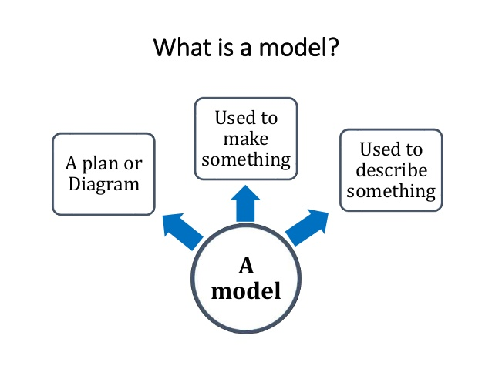

Slide 3
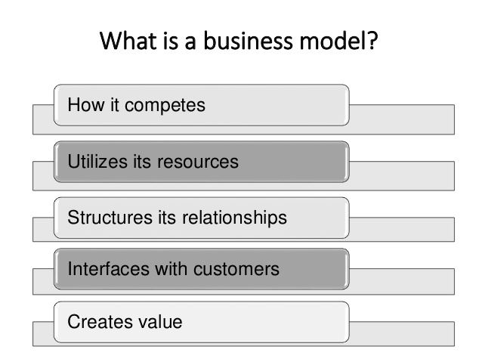

Slide 4
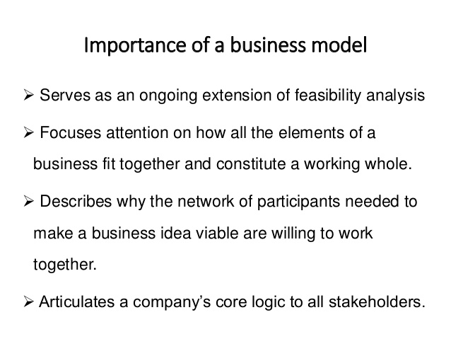

Slide 5
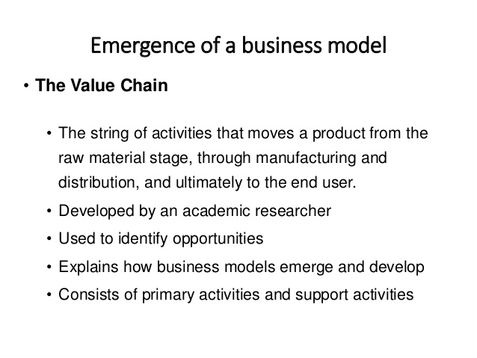

Slide 6
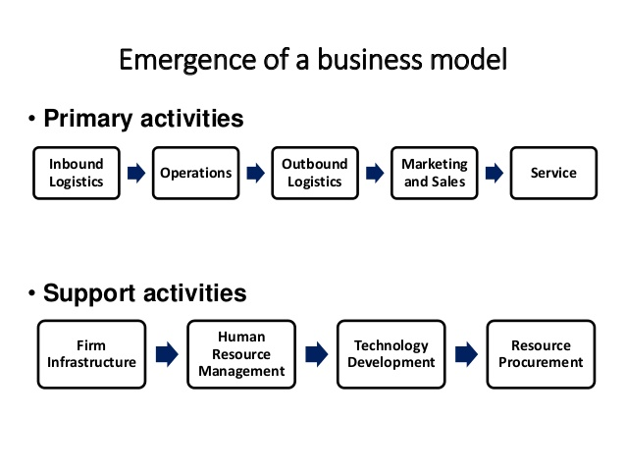

Slide 7
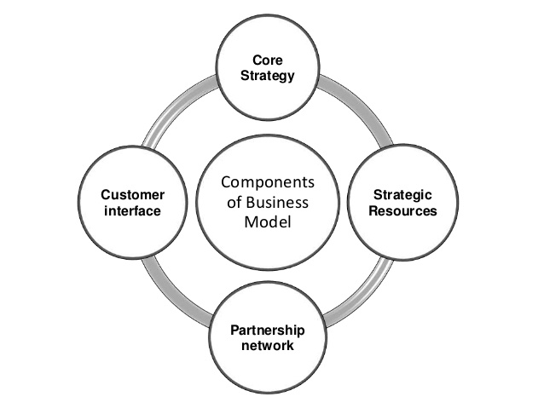

Slide 8
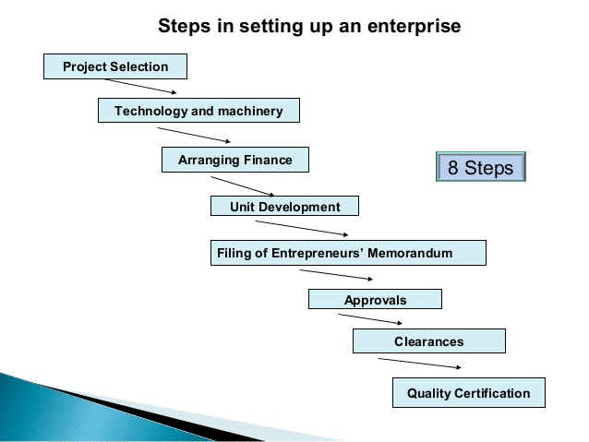

Slide 9

OSTERWALDER BUSINESS MODEL CANVAS

Slide 10
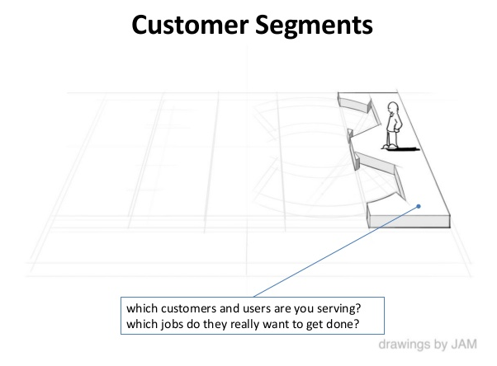

Slide 11
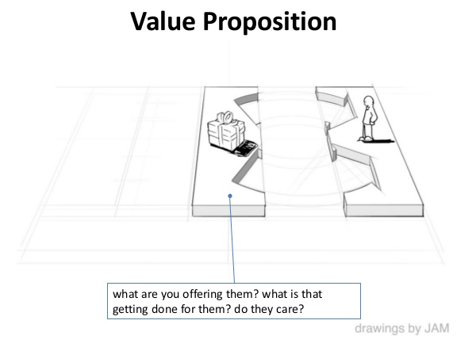

Slide 12
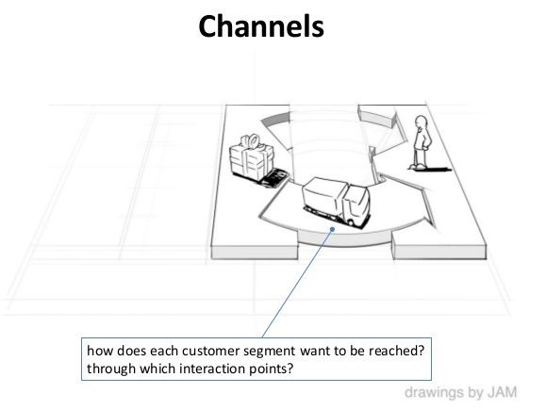

Slide 13
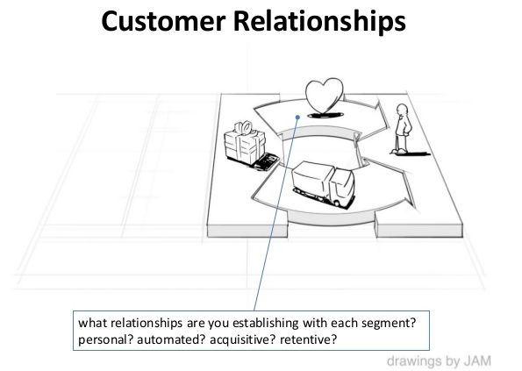

Slide 14
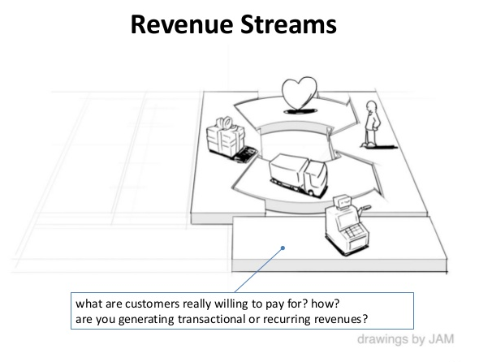

Slide 15
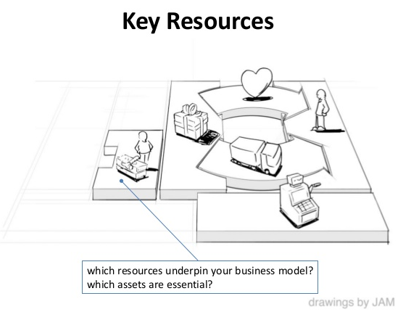

Slide 16
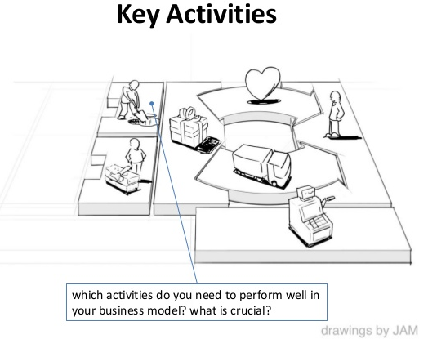

Slide 17
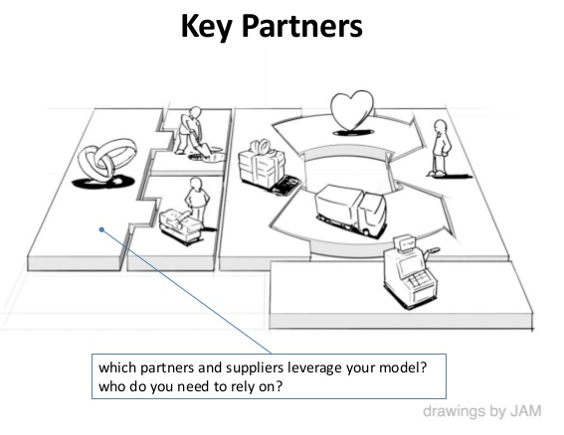

Slide 18
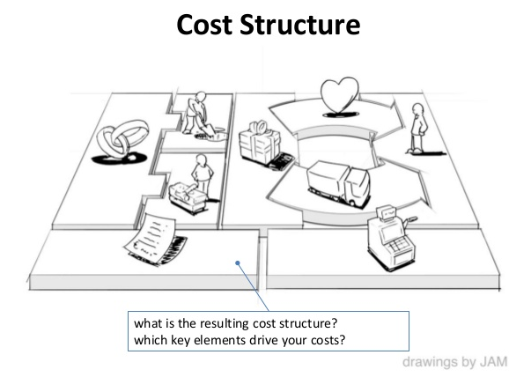

Slide 19
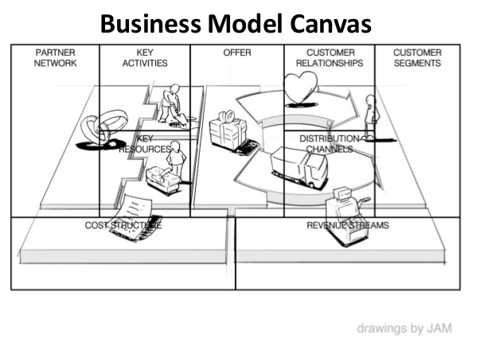

Slide 20
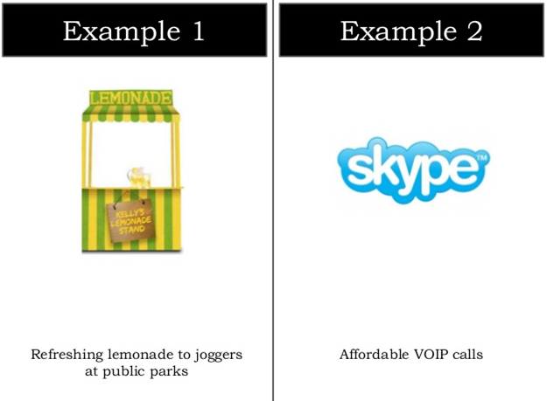

Slide 21
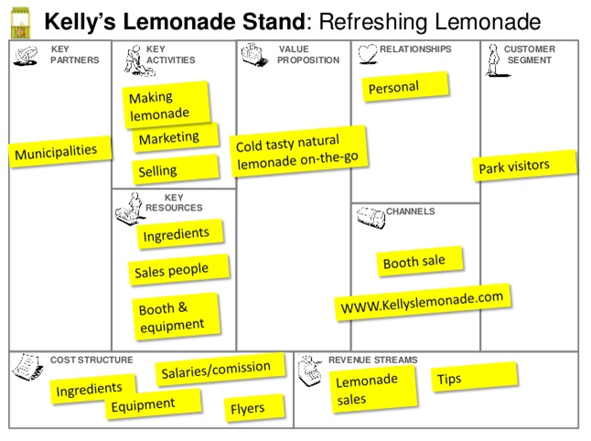

Slide 22
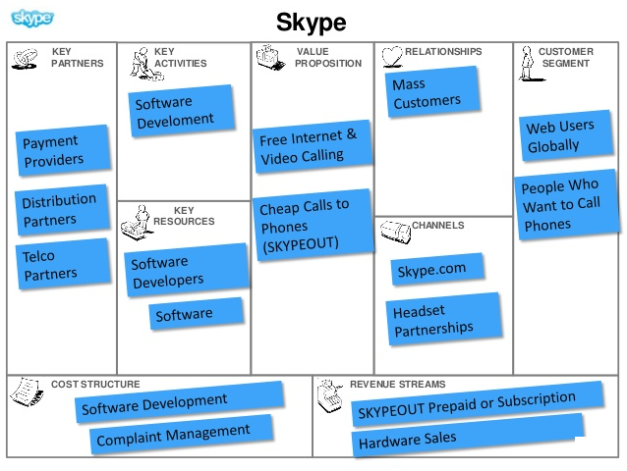

Slide 23
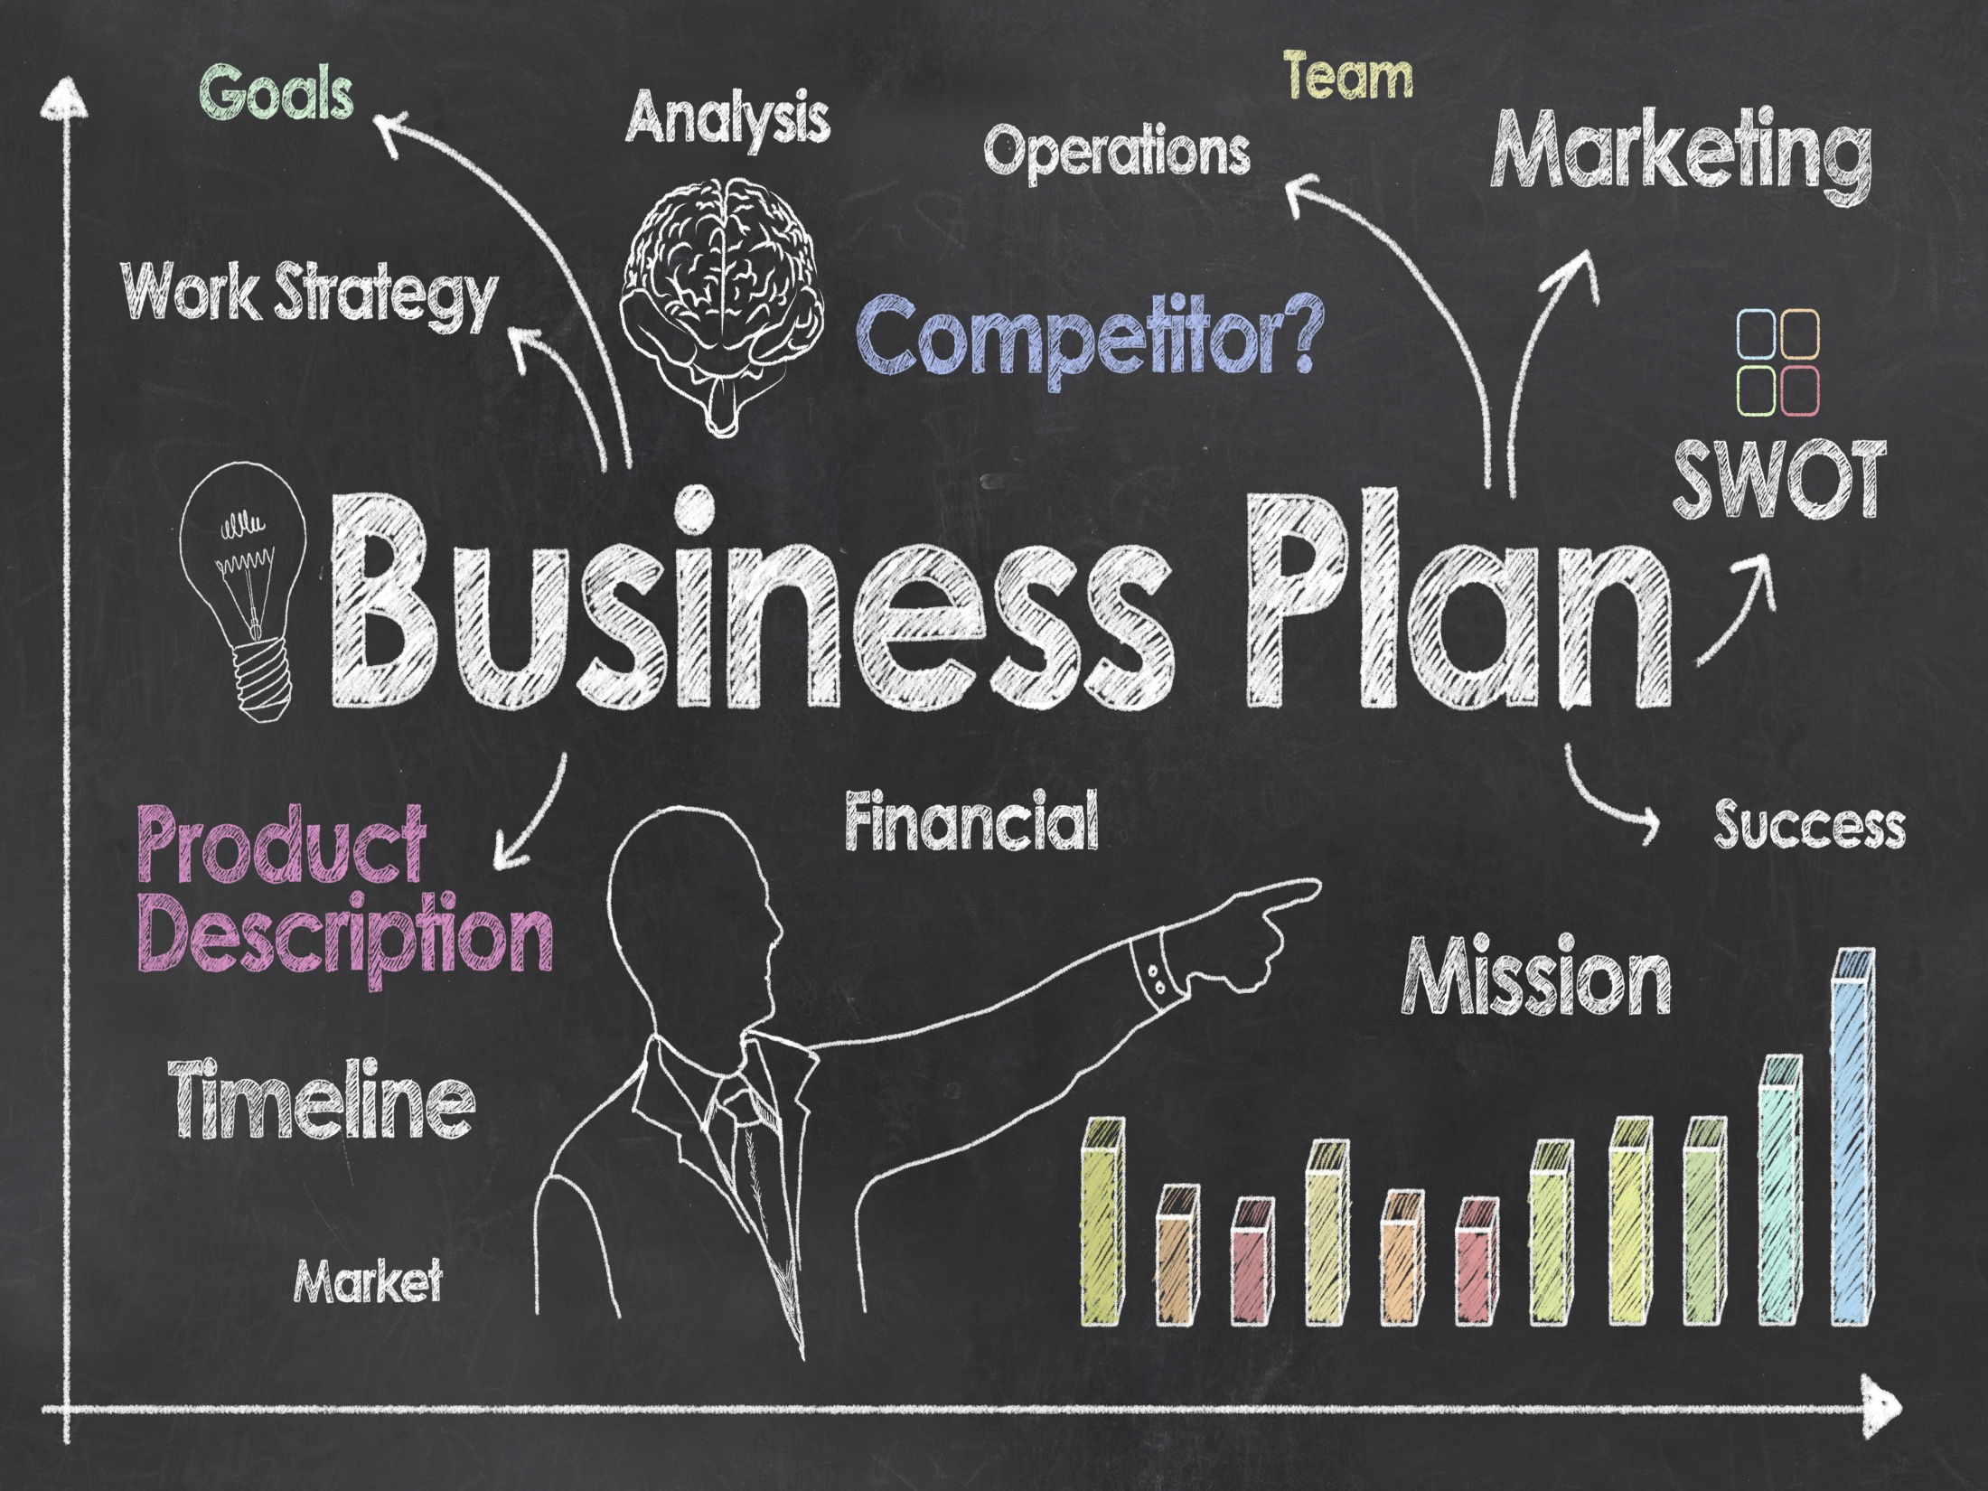

Slide 24
What is business plan?
A business plan is a comprehensive written description of the business of an enterprise.
Its main purpose is to present future of an enterprise.
It is a crucial element in any application for funding.

Slide 25
Why a business plan ?
Getting an integrated view of business.
Mutual understanding within the management team.
Determining financial needs and applying for fund.

Slide 26
Approval from board of director
Informing lender
Informing partner

Slide 27
Who reads business plan?
Commercial Banks
Private investment fund
Development fund
Multilateral development channel

Slide 28
Who prepares a business plan?
CEO
Marketing and sales manager
Development and production managers
Financial manager

Slide 29
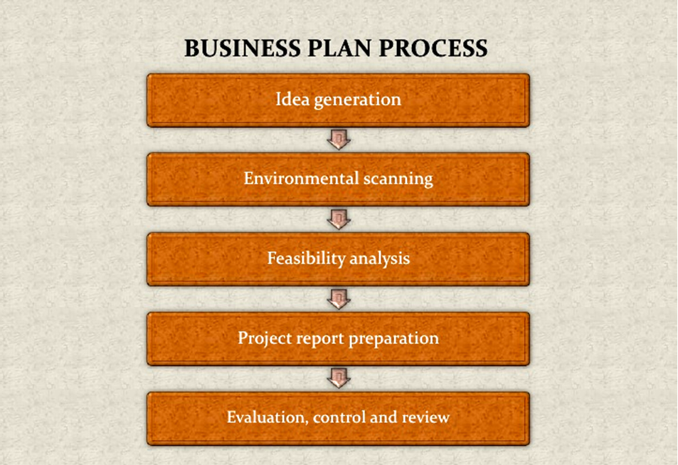

Slide 30
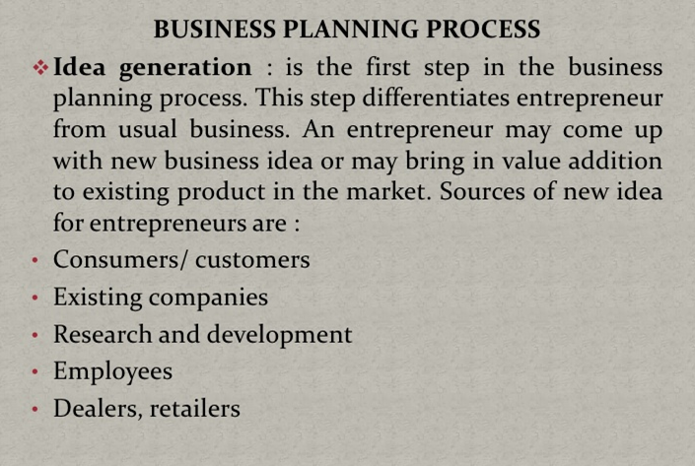

Slide 31
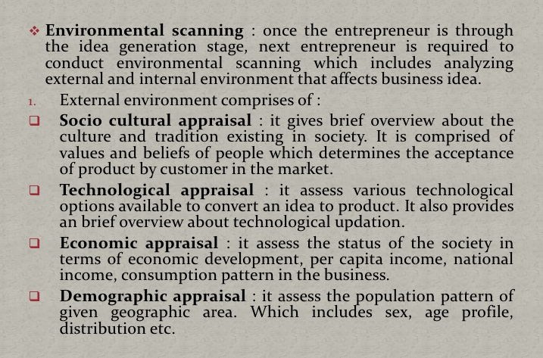

Slide 32
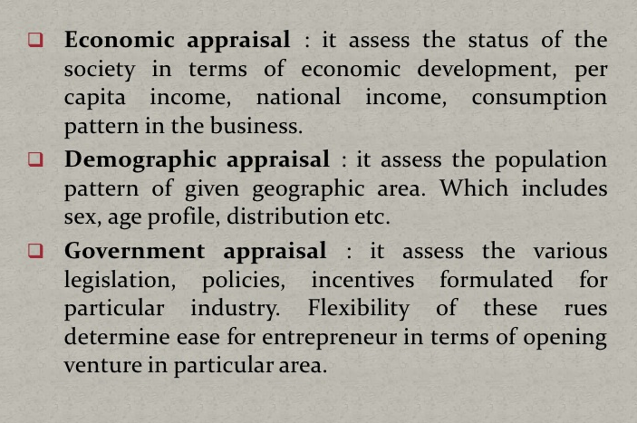

Slide 33
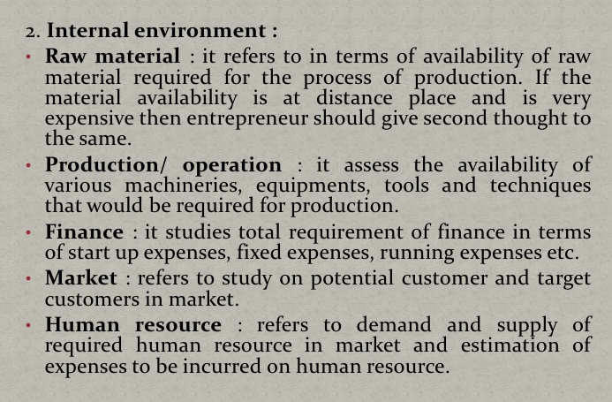

Slide 34
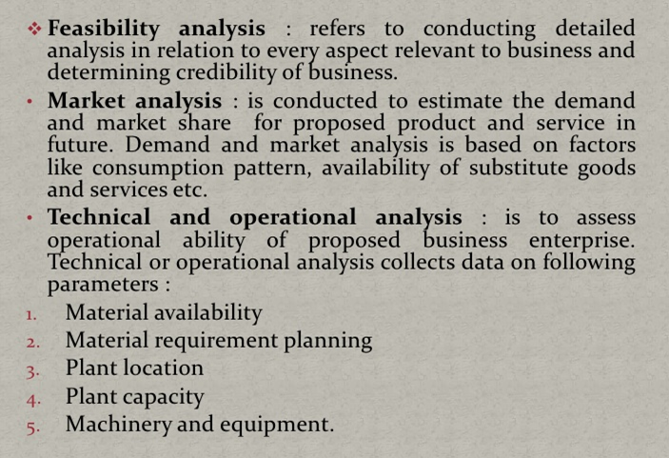

Slide 35
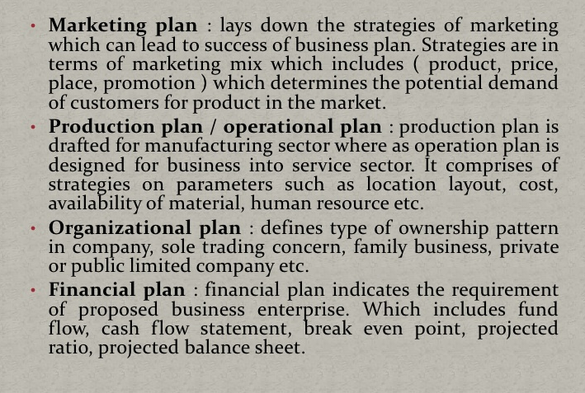

Slide 36
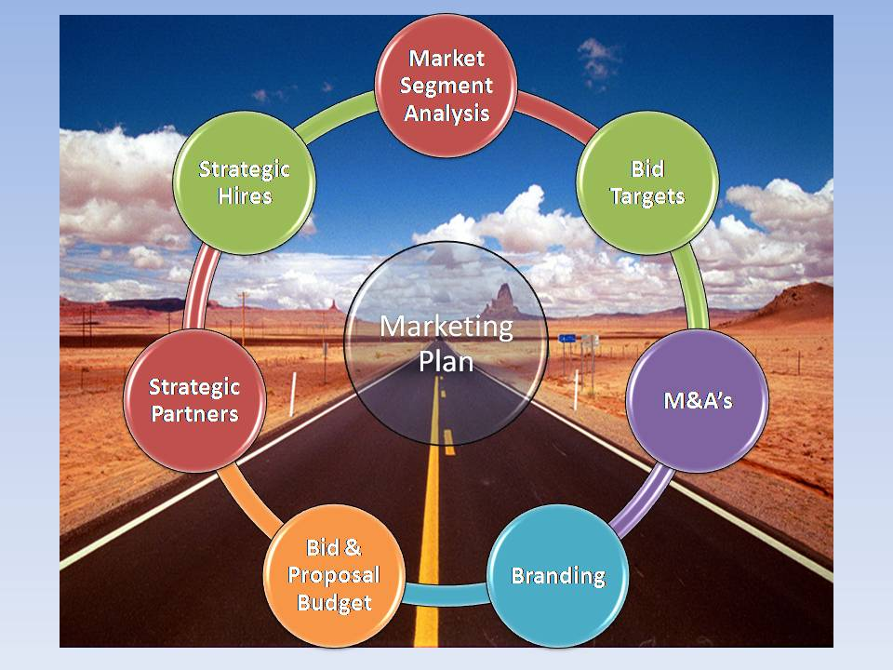
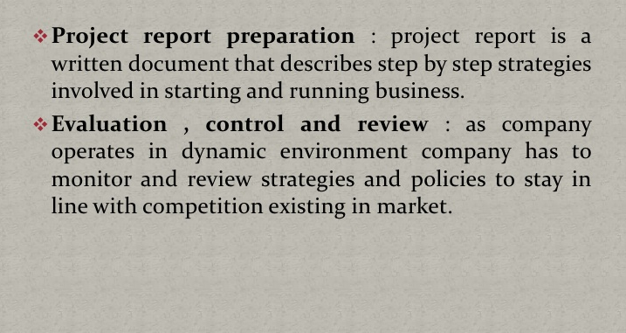

Slide 37
Advantages of Business Planning
Helps in convincing others
Reduction in emotional bias
Provide SWOT analysis
Develop consistent strategy
Achieve one’s commitment
Feasibility study
Action plan
Selling tool
Fund raising
Evaluating progress

Slide 38
Disadvantages of Business Planning
Discouragement for new ideas
Time
Tunnel Vision
Expense
Inflexible
Obsolete
Lack of Accountability

Slide 39
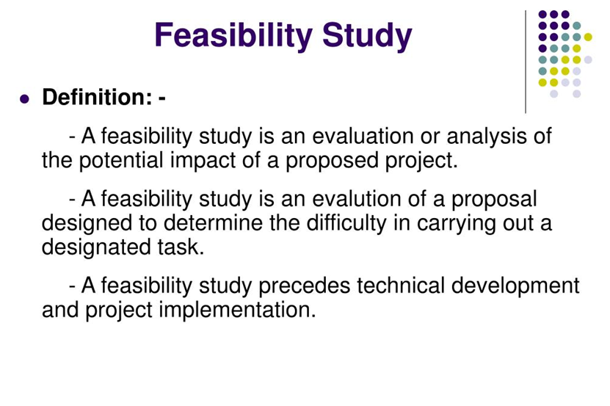

Slide 40
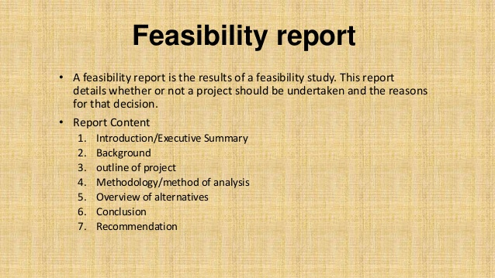

Slide 41
Contents of a Model Project Report
Cover Page
Table of Contents
Executive Summary
Marketing Plan
Technical Plan
Company Information
Operations Plan
Organizational Plan
Critical risk and Assumption
Project Timeline
Social Plan
Exit Strategy
Financial Plan
Conclusion
Appendices

Slide 42


